Slide 1

FEASIBILITY ANALYSIS AND PERFORMANCE TESTING OF COLLISION DETECTION ALGORITHMS FOR SATELLITES
Capstone Project Phase A
23-2-D-17
Hallel Weil
Omer Shamir
Supervisor: Mr. Ilya Zeldner

Slide 2

Introduction
Active\Old Satellites, Space debris
Satellites
Space debris
Finding possible collisions
Active satellites[orange]
Inactive satellites[Blue]
Space debris[Grey]
Rocket bodies[purple]
Uncategorized[pink]
1
2
3
4
5
6
7
8
9
10
11
12
Introduction
Background
Algorithm
Problem
Solution
User interface
Feasibility test
Optimization
Verification
plan
Challenges
Expected results
2

Slide 3
Introduction
Direct calculations are computationally expensive
Faster algorithms need to be tested
Implementing on a satellite on-board computer
Testing the algorithms
1
2
3
4
5
6
7
8
9
10
11
12
Introduction
Background
Algorithm
Problem
Solution
User interface
Feasibility test
Optimization
Verification
plan
Challenges
Expected results
3

Slide 4
Background
Finding the future orbit
Propagators
SGP4 Standard General Perturbations Satellite Orbit Model 4
LEMUR2[green] – COSMOS[blue]
1
2
3
4
5
6
7
8
9
10
11
12
Introduction
Background
Algorithm
Problem
Solution
User interface
Feasibility test
Optimization
Verification
plan
Challenges
Expected results
4

Slide 5
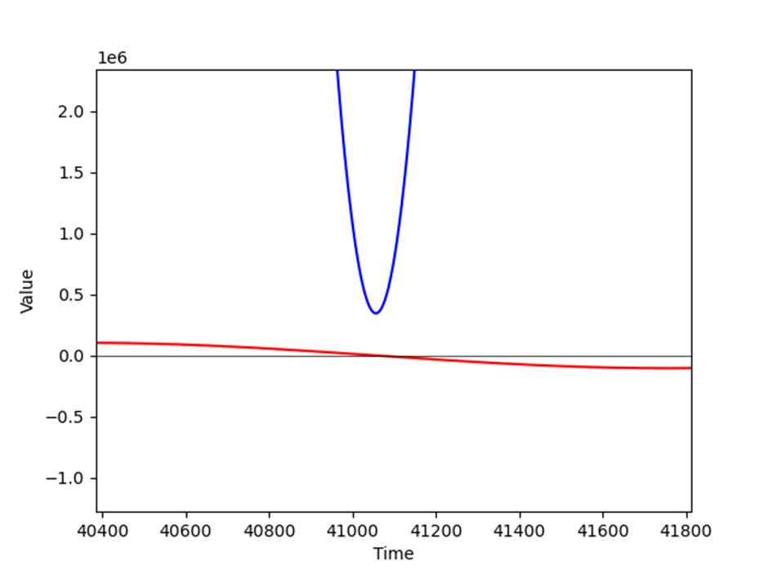
Background
Finding the minimal distance
– blue, - red
1
2
3
4
5
6
7
8
9
10
11
12
Introduction
Background
Algorithm
Problem
Solution
User interface
Feasibility test
Optimization
Verification
plan
Challenges
Expected results
5

Slide 6
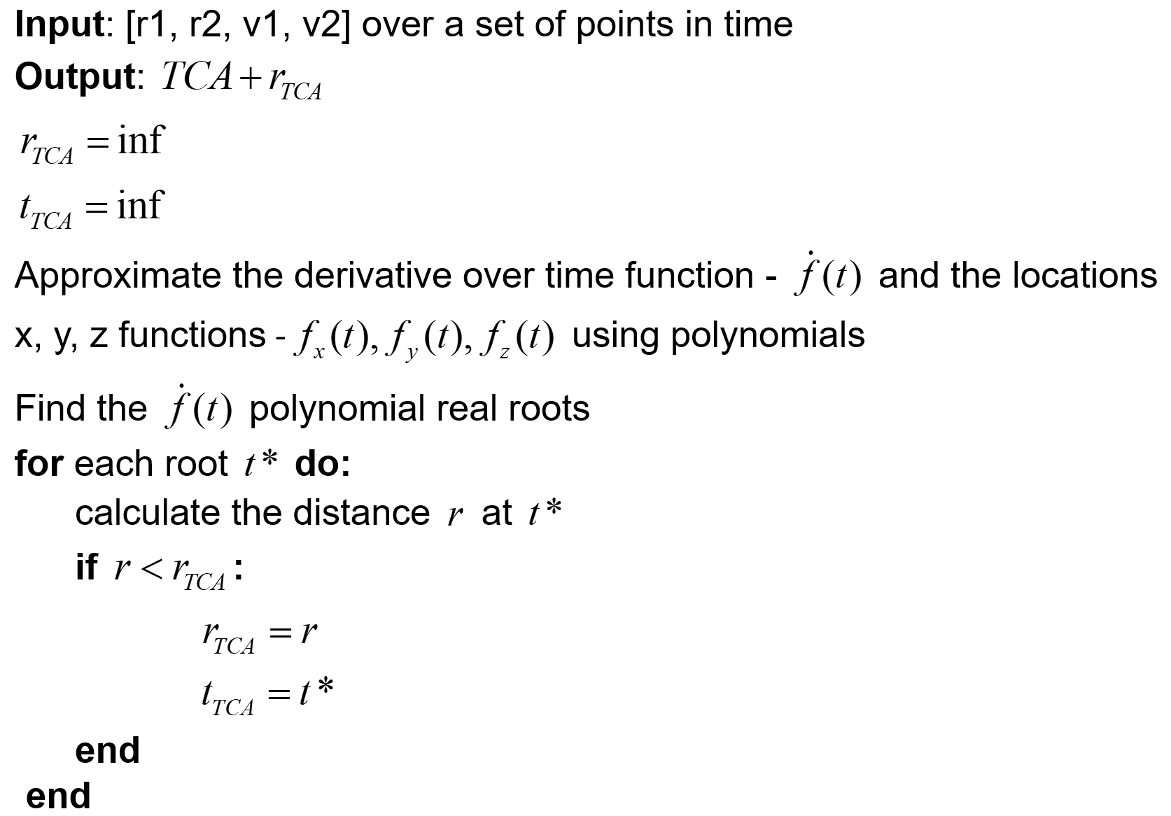
Algorithms
Approximations
using polynomials
1
2
3
4
5
6
7
8
9
10
11
12
Introduction
Background
Algorithm
Problem
Solution
User interface
Feasibility test
Optimization
Verification
plan
Challenges
Expected results
6

Slide 7
Algorithms
ANCAS - Alfano Negron Close Approach Software
Cubic polynomial using 4 points
Roots: solving a 3rd degree equation
1
2
3
4
5
6
7
8
9
10
11
12
Introduction
Background
Algorithm
Problem
Solution
User interface
Feasibility test
Optimization
Verification
plan
Challenges
Expected results
7

Slide 8
Algorithms
CATCH - Conjunction Assessment Through Chebyshev Polynomials
Using Chebyshev Polynomials
N degree polynomial using N+1 points
Roots: finding NxN matrix eigen values
1
2
3
4
5
6
7
8
9
10
11
12
Introduction
Background
Algorithm
Problem
Solution
User interface
Feasibility test
Optimization
Verification
plan
Challenges
Expected results
8

Slide 9
Problem
Autonomous satellite
Satellite on-board computer
Testing the algorithms
1
2
3
4
5
6
7
8
9
10
11
12
Introduction
Background
Algorithm
Problem
Solution
User interface
Feasibility test
Optimization
Verification
plan
Challenges
Expected results
9

Slide 10
Solution
Implementing the algorithms
Running on the satellite dedicated computer
Comparing run time and accuracy
1
2
3
4
5
6
7
8
9
10
11
12
Introduction
Background
Algorithm
Problem
Solution
User interface
Feasibility test
Optimization
Verification
plan
Challenges
Expected results
10

Slide 11
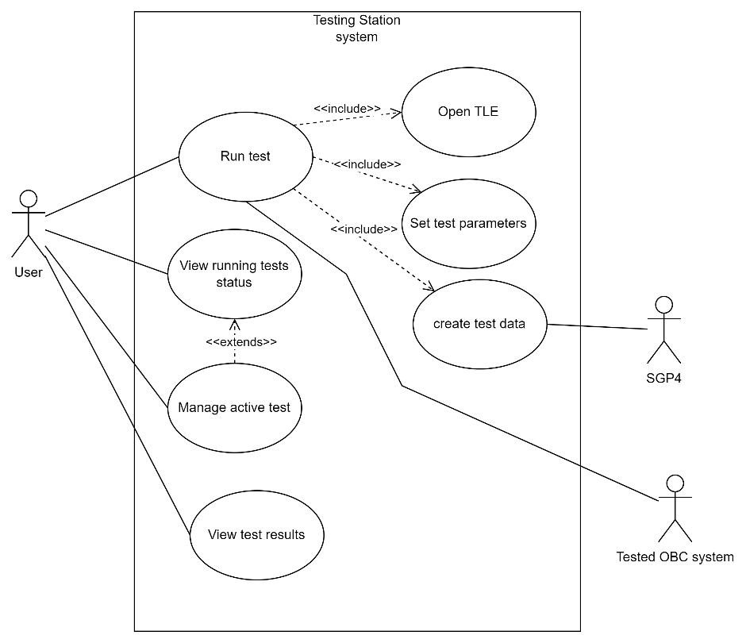
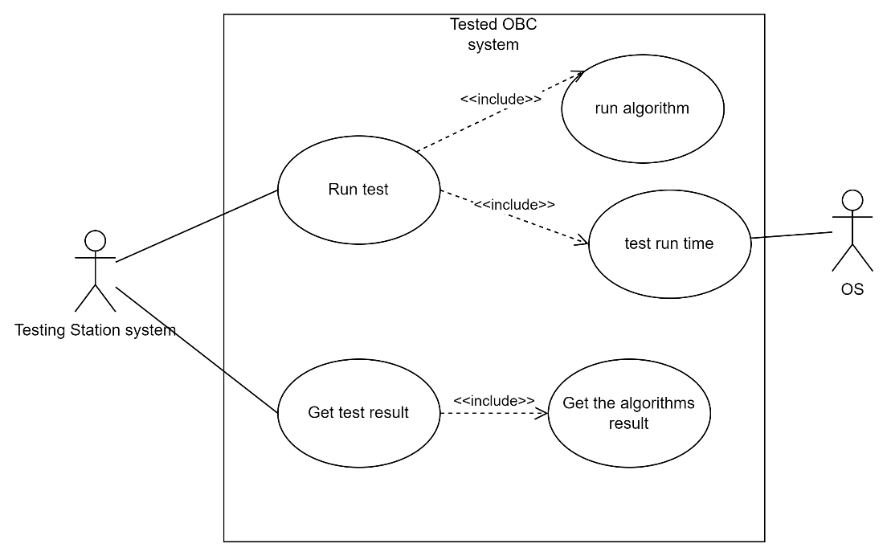
Solution
2 parts testing system
Testing station
Tested on-board computer
1
2
3
4
5
6
7
8
9
10
11
12
Introduction
Background
Algorithm
Problem
Solution
User interface
Feasibility test
Optimization
Verification
plan
Challenges
Expected results
11

Slide 12
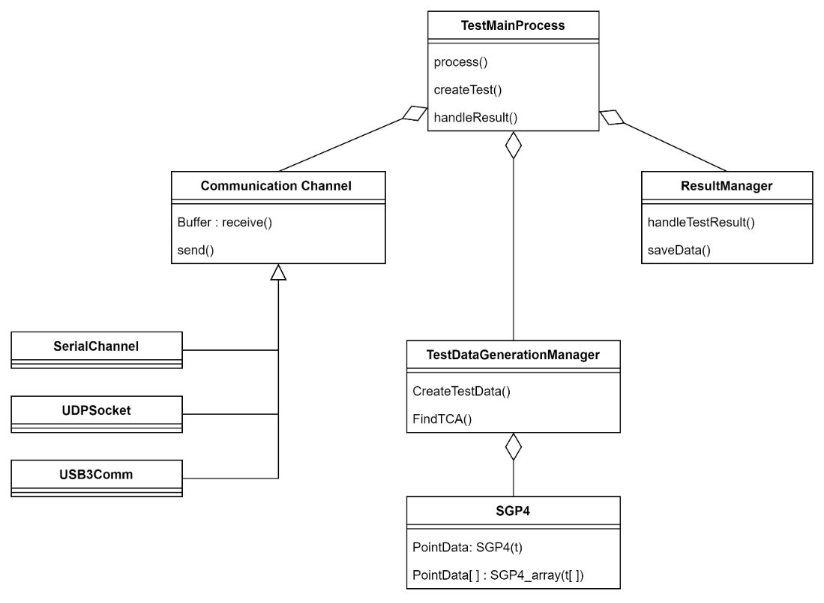
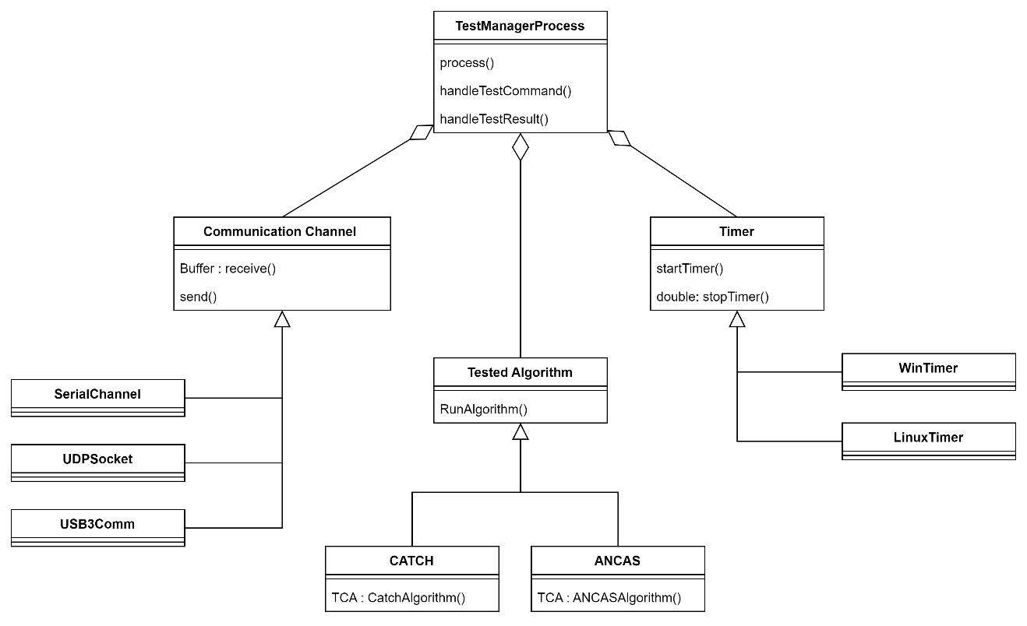
Solution
Testing station
Tested on-board computer
1
2
3
4
5
6
7
8
9
10
11
12
Introduction
Background
Algorithm
Problem
Solution
User interface
Feasibility test
Optimization
Verification
plan
Challenges
Expected results
12

Slide 13
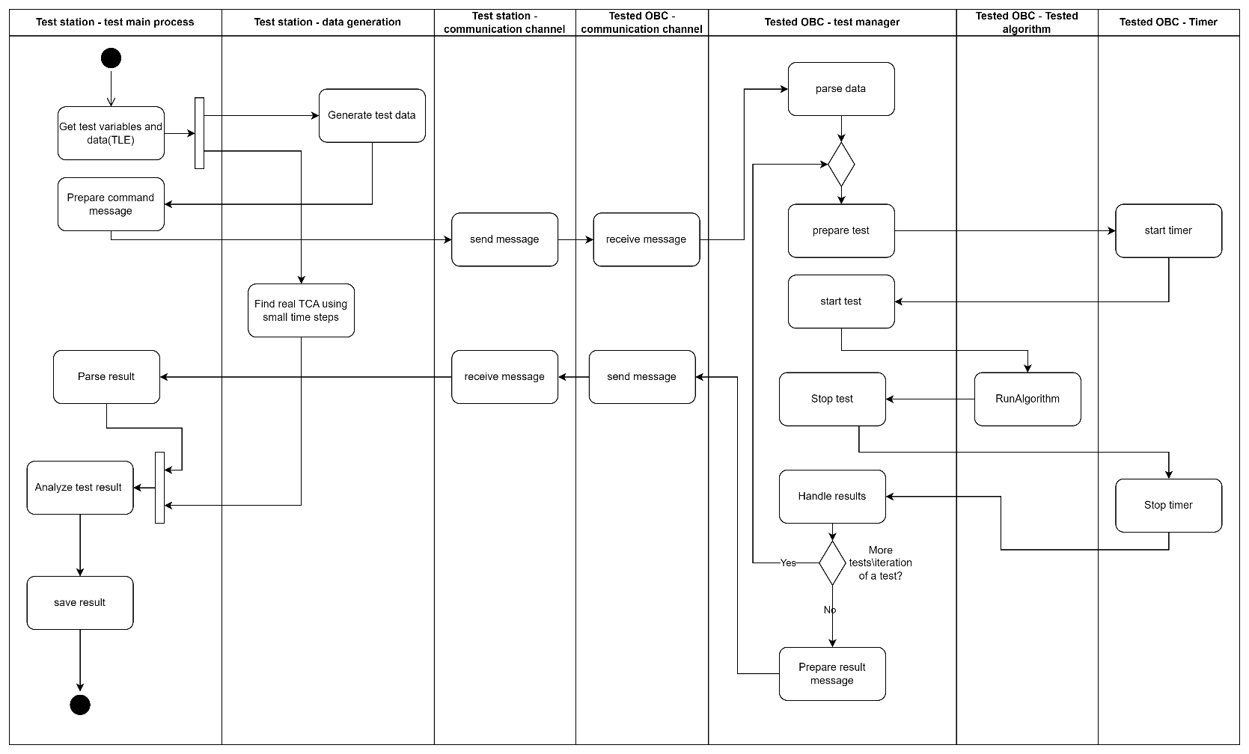
Solution
1
2
3
4
5
6
7
8
9
10
11
12
Introduction
Background
Algorithm
Problem
Solution
User interface
Feasibility test
Optimization
Verification
plan
Challenges
Expected results
13

Slide 14
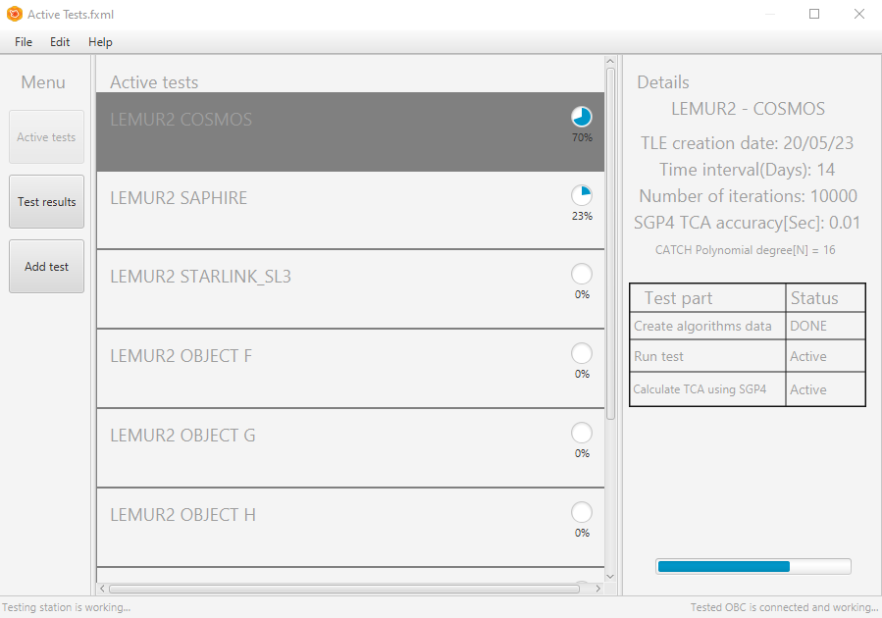
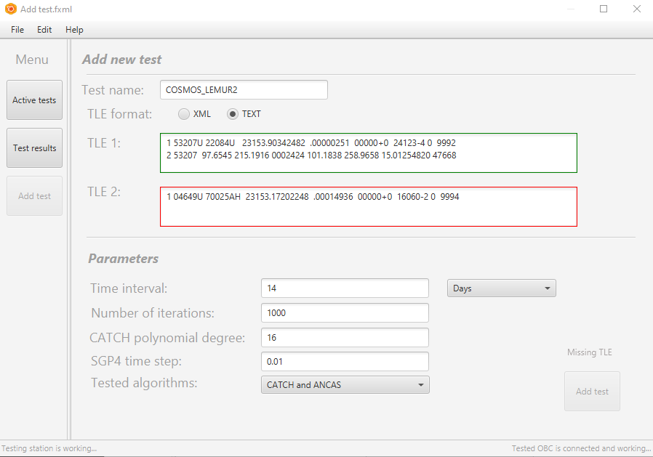
User interface
Active tests view
Adding a new test view
1
2
3
4
5
6
7
8
9
10
11
12
Introduction
Background
Algorithm
Problem
Solution
User interface
Feasibility test
Optimization
Verification
plan
Challenges
Expected results
14

Slide 15
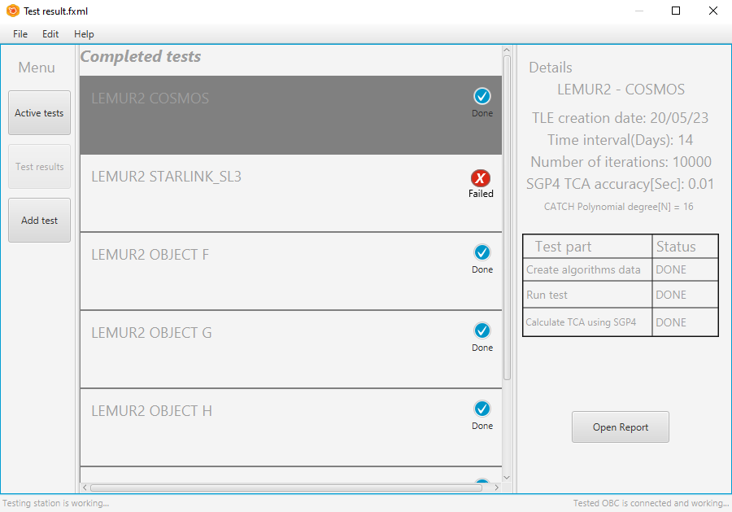
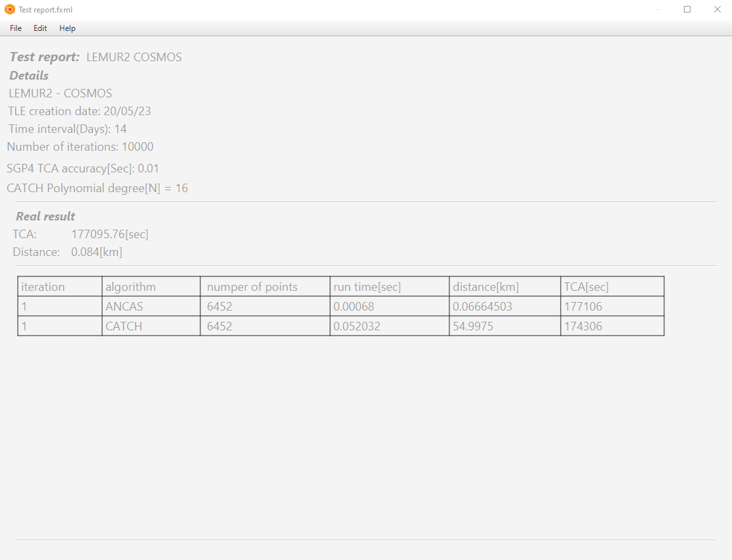
User interface
Test result's main view
Specific test result view
1
2
3
4
5
6
7
8
9
10
11
12
Introduction
Background
Algorithm
Problem
Solution
User interface
Feasibility test
Optimization
Verification
plan
Challenges
Expected results
15

Slide 16
Feasibility test
Implementing the algorithms
Running on our PC
Analyzing the result
1
2
3
4
5
6
7
8
9
10
11
12
Introduction
Background
Algorithm
Problem
Solution
User interface
Feasibility test
Optimization
Verification
plan
Challenges
Expected results
16

Slide 17
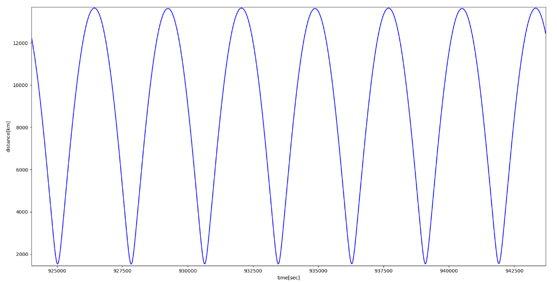
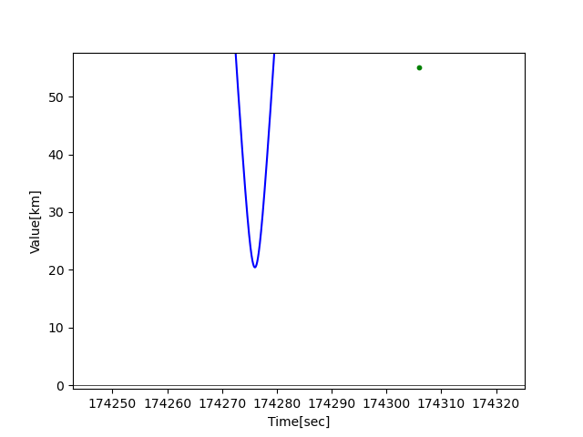
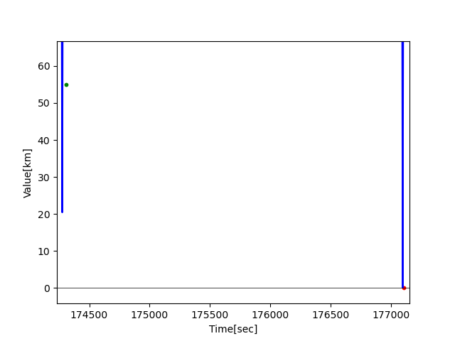
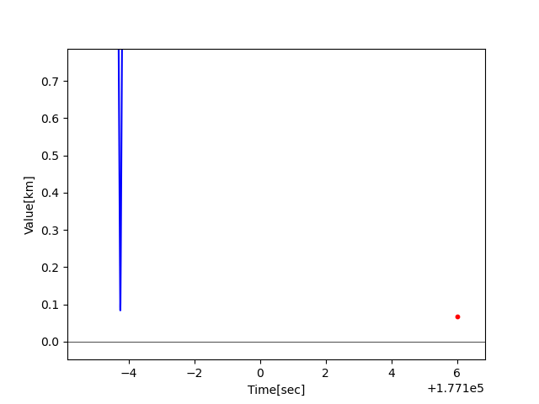
Feasibility test
Test case: LEMUR2 - COSMOS
ANCAS
ANCAS
CATCH
CATCH
1
2
3
4
5
6
7
8
9
10
11
12
Introduction
Background
Algorithm
Problem
Solution
User interface
Feasibility test
Optimization
Verification
plan
Challenges
Expected results
17

Slide 18
Optimization
Eigen alternatives
space–time trade-off
Minimize expensive calculations(Cos, sqrt, …)
1
2
3
4
5
6
7
8
9
10
11
12
Introduction
Background
Algorithm
Problem
Solution
User interface
Feasibility test
Optimization
Verification
plan
Challenges
Expected results
18

Slide 19
Verification plan
Testing using Bottom-Up methodology
3 levels:
Unit test, Local simulation, testing with the on board computer
1
2
3
4
5
6
7
8
9
10
11
12
Introduction
Background
Algorithm
Problem
Solution
User interface
Feasibility test
Optimization
Verification
plan
Challenges
Expected results
19

Slide 20
Verification plan
Testing Station
Tested OBC
# | Test description | Expected result
1 | Error in the input data: wrong input data (TLE, either one of the 2 required TLE or both) | No experiment is initiated, error message to the user.
2 | Error in the input data: Missing test variable (Number of iterations, CATCH polynomial degree) | No experiment is initiated, error message to the user.
3 | MSS (main success scenario), correct input values (TLE, variables). | Send correct message and data, save the correct result received from the simulation.
4 | Communication error: receive error message from the Tested OBC (simulated). | Try to send the data again, display error message to the user on repetitive errors.
5 | Communication error: no communication with the Tested OBC. | Display error message to the user.
# | Test description | Expected result
1 | Error in the input data: missing\out of bound test variables. | Send back error message.
2 | Error in the input data: missing data points (missing some of the values for a points in time data composed from r1,v1,r2,v2,t) | Send back error message.
3 | MSS (main success scenario) variations (run ANCAS/CATCH), correct input values (test variables, test data set). | Send back correct result.
4 | Communication error: receive error message from the Testing station. | Try to send the result message again, give up after repetitive errors.
5 | Communication error: no communication from the Testing station | Wait for the station response.
1
2
3
4
5
6
7
8
9
10
11
12
Introduction
Background
Algorithm
Problem
Solution
User interface
Feasibility test
Optimization
Verification
plan
Challenges
Expected results
20

Slide 21
Challenges
Developing for unknown / multiple systems
Testing and debugging
1
2
3
4
5
6
7
8
9
10
11
12
Introduction
Background
Algorithm
Problem
Solution
User interface
Feasibility test
Optimization
Verification
plan
Challenges
Expected results
21

Slide 22
Expected result
Testing system
Implemented, tested and ready to use algorithms
Experiments result, feasibility of the algorithms
1
2
3
4
5
6
7
8
9
10
11
12
Introduction
Background
Algorithm
Problem
Solution
User interface
Feasibility test
Optimization
Verification
plan
Challenges
Expected results
22

Slide 23
Bibliography
[1] Denenberg, Elad. "Satellite closest approach calculation through Chebyshev Proxy Polynomials." https://www.researchgate.net/publication/338609111_Satellite_Closest_Approach_Calculation_Through_Chebyshev_Proxy_Polynomials
[2] Alfano, S. "Determining Satellite Close Approaches-Part II.“
https://www.researchgate.net/publication/252559100_Determining_satellite_close_approaches_part_II
[3] NASA on orbital debris:
https://www.nasa.gov/mission_pages/station/news/orbital_debris.html
[4] AstariaGraph satellites and space debris visual map
http://astria.tacc.utexas.edu/AstriaGraph/
1
2
3
4
5
6
7
8
9
10
11
12
Introduction
Background
Algorithm
Problem
Solution
User interface
Feasibility test
Optimization
Verification
plan
Challenges
Expected results

